Slide 1
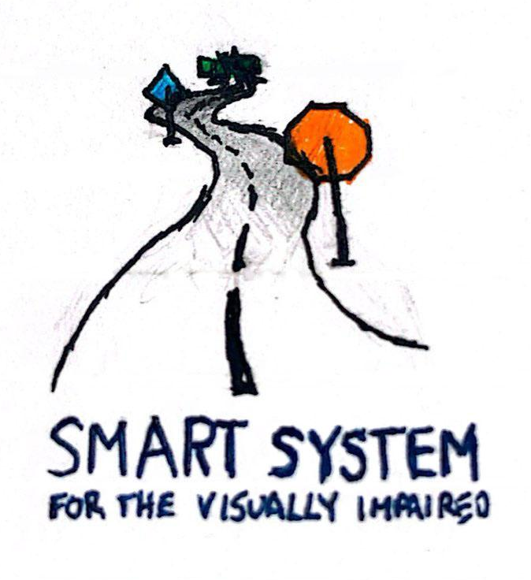
Smart System for Visually Impaired
Smart System for Visually Impaired
Experience the World

Slide 2
Value Proposition: Our Users
🧑🏻‍🦯‍➡️
For people with visual impairments 😎
Who want to better understand and navigate their environment independently, beyond the limited information provided by traditional aids. 🦻
Notes:
Note that sometimes you need more than one value proposition. For example if the beneficiary does not pay you, then you need one value proposition for your beneficiary and one for your paying customer.

Slide 3
Value Proposition: Our Product
🧢
⌚
The Smart System for the Visually Impaired is a dual-component wearable technology (smart cap and wrist device). 🤖
That provides comprehensive environmental awareness through real-time multimodal feedback, transforming visual information into consumable audio and haptic signals. ⛰️

Slide 4
Value Proposition: Our Advantages
📈
Unlike existing wearable assistive devices that focus on single-mode feedback or have limited environmental detection capabilities, 🦯
Our product creates a more complete understanding of the surroundings through an integrated dual-device approach that combines
computer vision
distance sensing
intuitive multimodal feedback systems
to translate the visual world into easily consumable information about objects, text, faces, and obstacles at all heights. 🦮

Slide 5
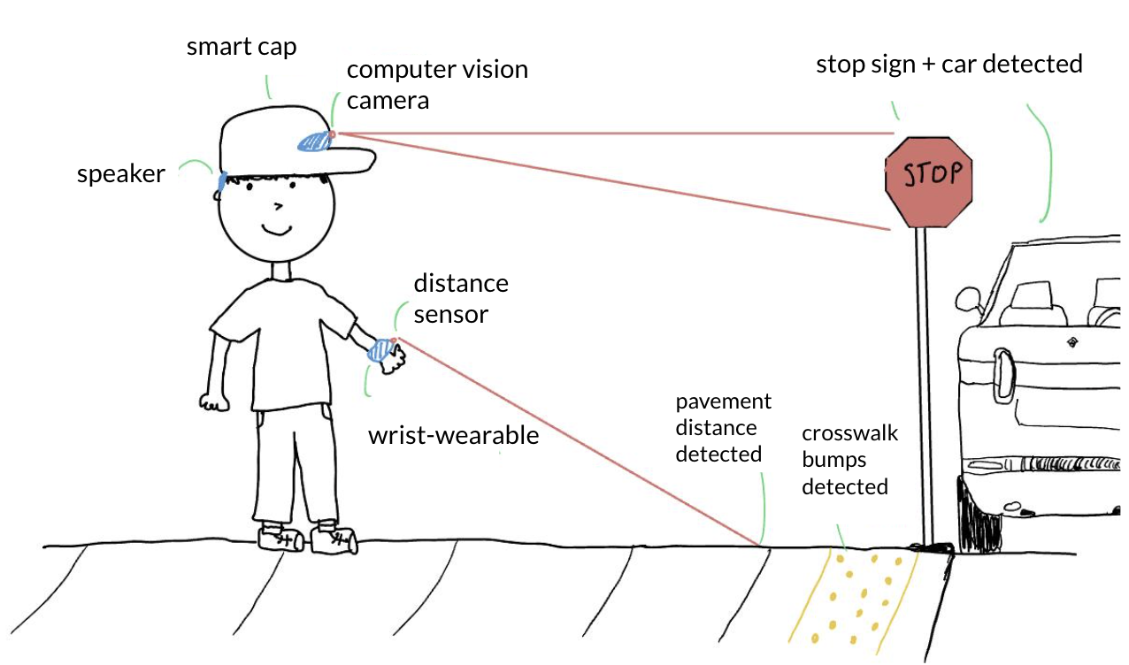
Our Design

Slide 6
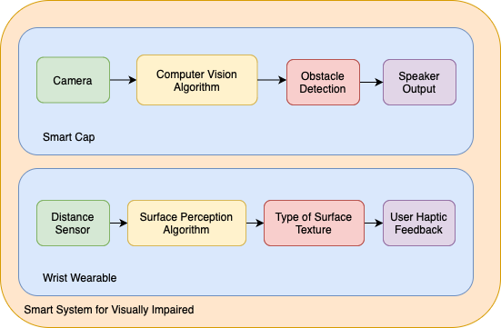
Our Design

Slide 7
M
V
P
Accurate environmental sensing
Mimicking of white cane functionality
Precise user haptic and auditory feedback
Ergonomic and simple to use

Slide 8
Smart System for Visually Impaired
Pair system of wrist-wearable and smart cap for visually impaired individuals designed to aid
navigation through impressive environment sensing and precise haptic and auditory feedback.
The Smart System empowers over 7 million visually impaired Americans with enhanced independence and safety, improving their social and professional opportunities through accessible, hands-free navigation technology.
Special Sauce
Real-time haptic sensory feedback through wrist-worn device to mimic white canes
Leverages computer vision for environmental awareness and object recognition
AI-powered voice assistant that allows users to verbally inquire about their surroundings
Technology Solution
Smart Cap with AI-powered vision
Wrist-worn haptic navigation device
Voice-activated environmental assistant

